Slide 1
“On the way with Python”

Slide 2
MD. SHAKIL
NSDA Certified Trainer & Assessor
Vendor Certified
IT Specialist in Python
Sr. Backend Developer
Ethical Den
Asst. Trainer
Daffodil International Professional Training Institute
Lead Trainer
eShikhon IT Training Institute
Lead Trainer
Wizard Software & Technology
📞 +88 01793-299882
✉️ shakil.eub.cse@gmail.com
🔗 https://www.linkedin.com/in/mrshakil015
🌐 https://mrshakil.com

Slide 3
Python Data Types
Lecture
04

Slide 4
Introduction
In Python, data types define the type of value a variable can store. Python is a dynamically typed language, which means you do not need to declare the data type explicitly. The interpreter automatically assigns the data type based on the value.

Slide 5
Why Data Types are Important
Data types are important because they:
Define what kind of data a variable holds
Decide which operations can be performed
Help prevent errors in programs
Improve program readability and logic

Slide 6
Data Types
Data Type | Example
int | 10
float | 10.5
str | "Hello"
bool | True / False
list | [1, 2, 3]
tuple | (1, 2, 3)
dict | {"name": "John"}
set | {"red", "green", "blue"}

Slide 7
Mutable vs Immutable Data Types
Mutable Data Types: These can be changed after creation
Immutable Data Types: These cannot be changed after creation.
Mutable | Immutable
list | int
dict | float
set | bool
 | tuple
 | str

Slide 8
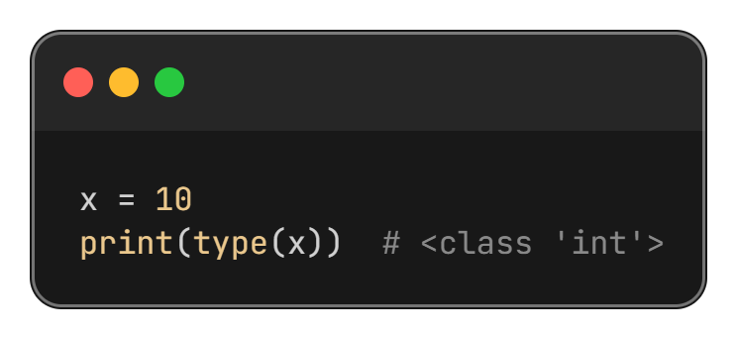
Checking Data Types
Use the type() function to check a variable's data type.

Slide 9
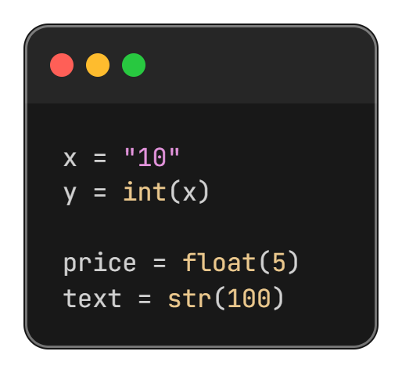
Type Conversion (Type Casting)
Converting one data type to another.

Slide 10
““Thanks All””

